Slide 1


SCRIBBLE
SERAP TAZEGÜL BURAK ERDAL KAAN KAVUNCUOĞLU
2014510100 2014510121 2013510052

Slide 2
OUTLINE
Project Description
Rules
Game Control
Encountered Problems and Solutions
ScreenShots
References

Slide 3
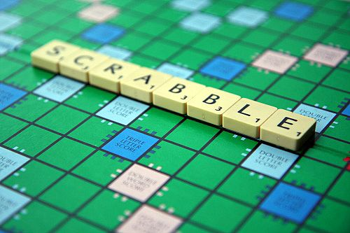
PROJECT DESCRIPTION
Scribble is a popular word game
The game is played on a board with 15x15 grid of cells

Slide 4
PROJECT DESCRIPTION
The aim of the project, increasing your letters on the board, getting a word with the letters and the word match to dictionary. Having the most point for the score when end of the game.

Slide 5
RULES
Each player have a bag containing 7 letters
Players can pass the turns twice.
Each player can query the dictionary max. 3 for each turn

Slide 6
GAME CONTROL
FOR
ALGORITHM OF
SCRIBBLE
QUERY
RETURNS
BAG
DETERMINE THE
LOCATION OF WORD
AND
COMPARE TO DICTIONARY

Slide 7
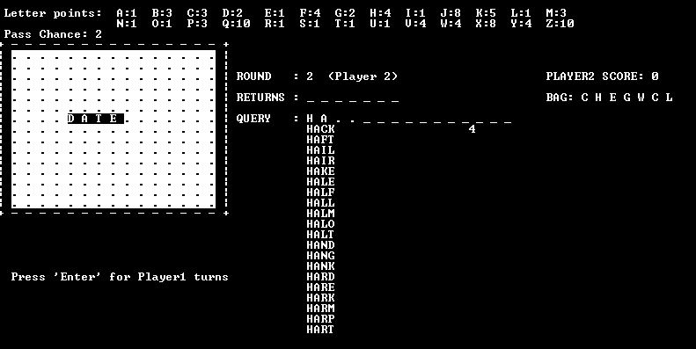
GAME CONTROL

Slide 8

ENCOUNTERED PROBLEMS
Encountered
Problems
Think and
discuss
Solution

Slide 9
ENCOUNTERED PROBLEMS
When players query the dictionary with dot, the count of letters in words.
Writing the board on the console screen for every round with array.copy

Slide 10
ENCOUNTERED PROBLEMS
To keep the letters on the board when players press the enter after add letter
Solutions;
else if (two_dimensional_board[i,j]!=null) Console.Write(two_dimensional_board[i, j]);

Slide 11
REFERENCES
http://lectures.cs.deu.edu.tr
http://wikipedia
http://github.com/

Slide 12

THANKS FOR LISTENING

